Slide 1

NATIONAL INSTITUTE OF TECHNOLOGY RAIPUR
Construction of Quantum Anamorphic Evolving Dynamic Threshold Secret-Sharing Schemes
Presented By :
Guided By :
Name : Pratibha Sikheriya & Eluri Sree Lakshmi
Roll - No : 22118075 & 22118034
Semester : 7th
Branch : Information Technology
Dr. Rajesh Doriya

Slide 2
Index
1.
2.
3.
4.
5.
6.
7.
8.
9.
10.
Introduction & motivation
Key definitions and preliminaries
Related work / literature review
Research gap & objectives
Proposed methodology (high-level)
Construction I: QAESS (Inspiration)
  Composite state construction
  Algorithm 1 (SHARE)
  Limitations of Construction I
Construction II (QAESS-SR) - Detailed
Algorithm 2 (Dealer-message & Party-key verification)
Security properties, advantages & limitations
Conclusion, references

Slide 3
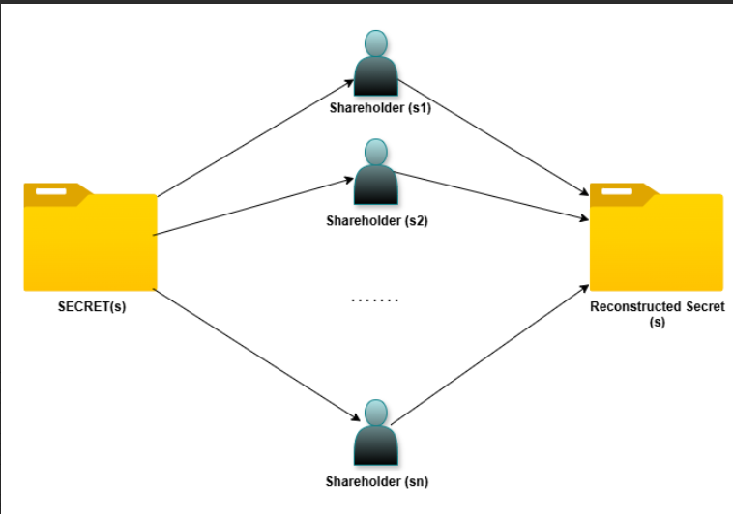
Introduction
Secret Sharing :
  A method to split a secret into multiple parts.
  Only when enough parts (threshold) combine, the secret is revealed.
Classical Encryption :
  Relies on algorithms like AES/RSA with keys for data security.
  Strong but vulnerable in the quantum era.
Quantum Secret Sharing :
  Shares secrets using quantum states & entanglement.
  Ensures stronger protection via no-cloning and quantum principles.

Slide 4
Introduction
Evolving Secret Sharing :
  Extends secret sharing to dynamic systems.
  New members can join and get shares without restarting the whole scheme.
Anamorphic Encryption :
  Embeds hidden/covert messages inside normal ciphertext.
  Provides Indistinguishability.
  Provides plausible deniability against powerful adversaries.
  Indistinguishability → Encrypted data looks the same to an attacker, whether it hides extra info or not.
  Plausible Deniability → You can safely deny the presence of hidden data, and the attacker can’t prove otherwise.

Slide 5
Motivation (why this problem matters)
  Censorship or dictator model : must present a plausible innocuous secret while secretly retaining covert data.
  Real systems evolve — new parties join over time; static threshold SS fails with quantum no-cloning constraints.
  Need: adaptive thresholds + covert embedding that doesn't increase quantum-state dimension noticeably.
  No-Cloning Theorem → A quantum state cannot be copied exactly.
  Why it matters → In secret sharing, if too few participants could reconstruct, two disjoint groups could clone the secret, violating quantum rules.
  So in our project → Thresholds must adapt with growing participants to stay consistent with no-cloning.

Slide 6
Key building blocks (preliminaries)
  Anamorphic Encryption (AE): two-layer ciphertexts; regular key vs anamorphic key; indistinguishability & plausible deniability.
  Evolving Secret Sharing (ESS): dynamic parties over time with threshold function k(t).
  Quantum Secret-Sharing (QSS) & Trap Codes: QECC + X/Z trap qubits + random permutation + Pauli one-time pad.
  Counting-based SS (CBSS): used as intuition for majority/bit-count reconstruction in related classical schemes.

Slide 7
Chaudhury & Ganguly, IEEE TCOM, 2025 | Combines Anamorphic Encryption + Evolving Secret Sharing; uses trap codes, permutations, secret redistribution | Dynamic thresholds avoid no-cloning Secret redistribution cuts memory & stops spies Proven scalable & robust | IoT updates, edge devices, autonomous vehicles, quantum internet, federated learning, covert comms
Persiano et al., EUROCRYPT 2022 | Embeds normal + covert messages in ciphertext; uses anamorphic keys; ensures deniability | Works under coercion/dictator model Zero-latency covert channel Key escrow/backdoors can’t kill privacy | Dissident/journalist comms, human rights, censorship resistance, crypto resilience
Quantum Anamorphic Encryption with Dynamic Trap Codes (Ganguly, 2025) | Introduces quantum anamorphic encryption (QAE) with dynamic trap codes, Ciphertext embeds both normal & covert secrets | Achieves indistinguishability between normal and anamorphic ciphertexts Provides tamper detection via trap codes Dynamic key evolution prevents key exhaustion | Quantum internet protocols (tamper-proof routing),Military & diplomatic secrecy
Related work / literature
Reference
Methodology
Key Findings
Application

Slide 8
Related work / literature
IEEE (2025), 2025-370.pdf | Formal analysis of quantum-safe authentication & key distribution. | Enhanced resistance to quantum attacks; integration with post-quantum primitives. | Quantum internet, secure 6G, IoT comms.
Ganguly & Chaudhury (2025) | Theoretical models & proofs for quantum anamorphic encryption and secret-sharing. | Quantum ciphertexts can hide covert messages. Defined quantum anamorphic secret-sharing. Secure against quantum adversaries. | Covert comms in quantum networks, whistleblowing, diplomacy, hidden cloud storage.
Chu, Do, Hanzlik & Thyagarajan (2025) | Formal cryptographic models combining anamorphic signatures with threshold cryptography. | Proposed threshold-recipient anamorphic signatures. Showed communication possible even if dictator controls keys. Impossibility of threshold-sender schemes in many cases. | Secure whistleblowing, multi-device secrecy, resistance under enforced eIDs, guidance for standards.
Reference
Methodology
Key Findings
Application

Slide 9

Research gap
1. Algebraic Integration :
  No use of Galois fields for compact permutation/Pauli generation.
  Dealer memory still grows excessively with generations.
2. Efficiency :
  Prior work only provides asymptotic complexity bounds.
  No practical time–space benchmarks for encoding, sharing, and reconstruction.
3. Security Verification with Hashing
  Literature does not provide a unified model integrating:
Quantum attack detection (PNS, MITM, Trojan, Intercept-Resend)
Fidelity-based quantum state validation
SHA-512 cryptographic commitment for message and key integrity
  No comparison of security or fidelity consistency across different input types.

Slide 10
Research objectives
  To develop a Galois field–based implementation model for compact keying and permutation/Pauli generation.
  To evaluate the time–space complexity of share generation, distribution, and reconstruction under evolving thresholds.
  To test the security robustness of the protocol by modeling spy-insertion attacks under normal and redistribution policies.

Slide 11
Novelty of work
  First attempt to move QAESS from pure theory to an implementation model.
  No existing work has integrated anamorphic encryption + evolving secret sharing into executable quantum circuits.
  Objective : To establish a proof-of-concept implementation that validates QAESS functionality under fidelity and various attack analysis, bridging the gap between cryptographic theory and practical quantum hardware.

Slide 12







Attack
SENDER
RECEIVER
Message
  Normal secret
  Covert secret

Slide 13
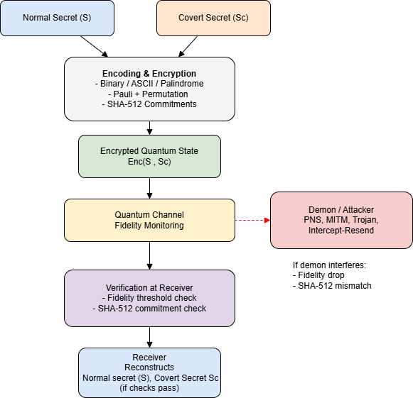
Flow Chart

Slide 14
Construction I: QAESS (overview)
  Generations of parties → Participants join in waves G1,G2,…
  Dealer’s role per generation:
– Builds a composite state = parent secret ⊗ random state (with covert message).
– Shares this composite state using Quantum Threshold Secret Sharing (QTSS).
  Random states → Fresh states are prepared each generation; they carry the covert message and are merged with the main secret.
  Tuples P = (f1, … ,fg) Dealer keeps track of how many parties from each generation must collaborate to reconstruct the secret.

Slide 15
Composite state (visual + idea)
  Base state → Encode the normal secret with QECC: Enc(Secret).
  Add traps → Append |0⟩ (X-traps) and |+⟩ (Z-traps) for error detection.
  Permutation (σ_k1) → Randomly permute all qubits, mixing traps + encoded secret.
  Pauli mask (P_k2) → Apply a quantum one-time pad for extra security.
  Covert embedding → Hide covert message by fixing permutation pattern on some trap qubits.

Slide 16
Algorithm 1: QAESS SHARE — Purpose & inputs
Purpose :
  To distribute a quantum secret in an evolving multi-generation setting.
  Embed a covert (anamorphic) message within trap qubits.
  Ensure adaptive thresholds while maintaining low dimension blow-up.
Inputs :
  |S⟩ → Normal secret state.
  |S_c⟩→ Covert secret state.
  g → Current generation index.
  P = (f₁,…,f_g) → Tuple of participant indices across generations.
  Classical keys → Permutation σ, Pauli mask, trap positions (for verification).

Slide 17
Algorithm 1: Step-by-step
  Encode the normal secret using quantum error-correcting code to protect it from noise and tampering.
  Add trap qubits and embed the covert secret inside their pattern, without increasing the state dimension.
  Apply a global permutation and Pauli masking to hide both the secret and trap positions from any observer.
  Generate per-party quantum shares using threshold secret sharing so only an authorized group can reconstruct the secret.
  Distribute final composite shares across generations, allowing the system to evolve securely as new participants join.

Slide 18

Limitations (Construction I)
Limitations :
  Dealer memory grows exponentially with generations → must store many permutations & Pauli keys.
  Share state dimension increases rapidly:

Slide 19
Why Construction-2 Replaces Construction-1
Construction-1 rebuilds a full parent composite state for every generation, causing the dealer’s memory and re-distribution cost to grow exponentially. Each new generation depends on recreating and storing all previous shares, making the model secure but impractical.
Construction-2 replaces this with a parent–child redistribution flow, where each party simply updates its own share and passes a small child-share to the next generation. This removes global recomputation and reduces memory from exponential to linear, enabling scalable multi-generation sharing while still keeping covert security intact.

Slide 20
Construction-2 (QAESS-SR)
  Construction-2 is introduced to replace the heavy, non-scalable behaviour of Construction-1.
  It keeps the same covert + anamorphic guarantees but redesigns how shares evolve across generations.
  Core Innovation:

Slide 21
Why Construction - 2?
  Construction-1 becomes expensive as generations grow.
  Construction-2 fixes this by restructuring the protocol.
  Addresses core problems:
1. Exponential dealer memory → Linear memory
2. Rapidly growing share dimension → Linear dimension O(I)
3. Heavy recomputation → Local updates only
4. Unsustainable for long-running systems → Fully scalable

Slide 22
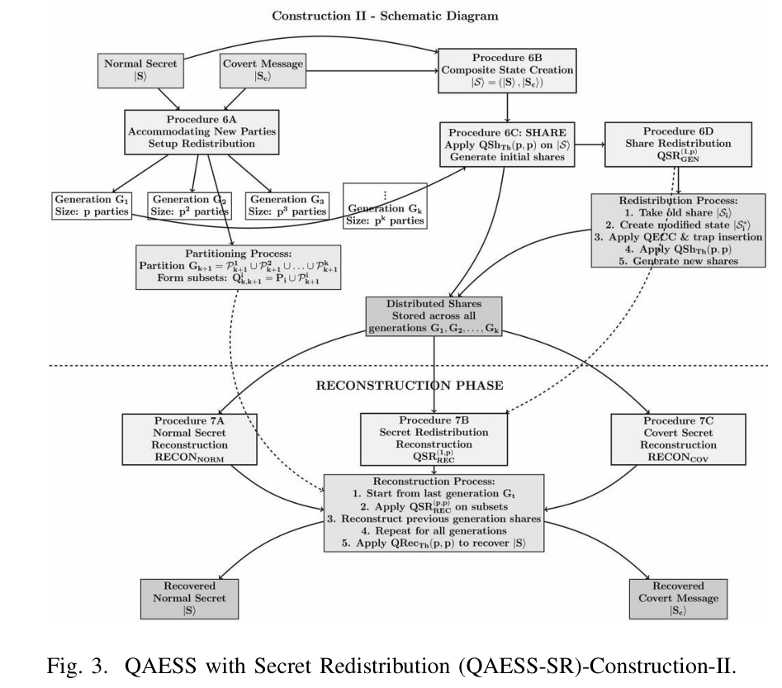
Construction-2 (QAESS-SR) Flow Chart

Slide 23
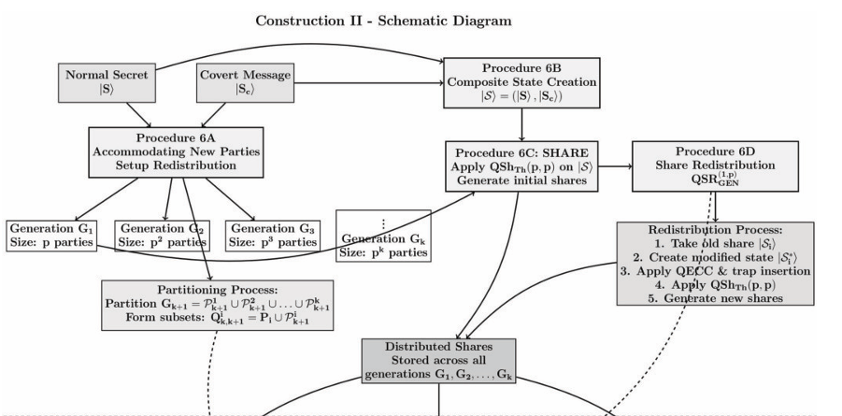
Construction-2 (QAESS-SR) Flow Chart

Slide 24
Overall QAESS-SR Scheme
  6A – Accommodation of new participants
Place new parties into next unfilled generation (Gi).
  6B – Composite state creation |Sᵢ⟩ = (|Sᵢ⟩, |Sᶜᵢ⟩)
Same trap-code composite construction as Construction 1
  6C – Overall SHARE
First generation G₁ gets shares via (p, p) QTSS QShTh(p, p).
Later generations get shares via redistribution of previous generation shares.
  6D – Redistribution
Modify share of old party Pᵢ and spread to subset Pᶦₖ₊₁ in Gₖ₊₁ via QTSS.

Slide 25
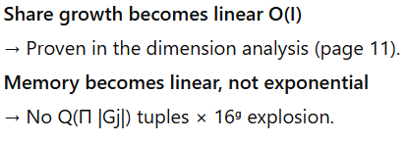
Key Idea: Redistribute, Don’t Re-create
Each party in generation Gₖ performs a local transformation of its own share and passes only minimal encoded data to the next generation Gₖ₊₁.
  Pipeline:
Take own share
Applies a trap-code based modification
Apply threshold sharing locally
Each child receives a small “redistributed child share”
Next generation reconstructs only the parent’s modified share
  Result → No global refresh, no huge states, no exponential blow-up.

Slide 26
Internal Blueprint of Construction-2
Construction-2 composes multiple quantum + classical layers:
Quantum Layer :
  Steane [[7,1,3]] encoding of S[0]
  4-part trap partitions (n₁, n₂, n₃, n₄)
  Trap condition: n₁ ⊕ n₂ = n₃ ⊕ n₄
  Covert secret encoded on dedicated qubits
  Randomized permutation σₖ₁
  Pauli mask Pₖ₂
Classical Layer :
  GF(2¹³) Shamir sharing for k₁, k₂
  SHA-512 commitments for all verifiable parameters

Slide 27
Composite State Structure
The composite quantum state created in Construction-2 has the precise order:
|Ψ⟩ = Enc(S[0]) ⊗ n₁ ⊗ n₂ ⊗ n₃ ⊗ n₄ ⊗ Sc ⊗ r_Pⱼ
Where:
  Enc(S[0]) = Steane encoding
  n₁–n₄ = trap-based embedding of S[1:8]
  Sc = covert secret
  r_Pⱼ = random Pauli components
This structure ensures secrecy, detectability, and compatibility with redistribution.

Slide 28
Efficient Share Generation
Construction-2 applies a small (p,p) QTSS to each party individually.
For each party Pᵢ in generation Gₖ:
Pᵢ generates:
  A new mini-share to keep
  Child-shares for parties in Gₖ₊₁
  Updated trapped + covert structure
This reduces workload from global → local, enabling linear complexity.

Slide 29
Complexity Advantages
Dealer Memory
  From: O(∏|Gₖ|)
  To: O(Σ|Gₖ|)
  ➡ Only stores data per generation, not per combination.
Share Dimension
  From: heavy polynomial O(I⁴ log I (log log I)²)
  To: O(I)
  ➡ Scales smoothly with party index.
Time Complexity
  No exponential recomputation
  Redistribution scales with generation size
  Quantum operations remain constant-depth

Slide 30
Algorithm 2: Dealer-message & Party-key verification — Purpose
  Ensures the distributed quantum state and keys are authentic and untampered before reconstruction.
  Validates that each party holds the correct permutation, Pauli mask, and trap indices.
  Prevents spy insertion, dishonest dealer, and forged share injection.
  Guarantees Plausible Deniability — participants can safely reveal only the normal secret without exposing the covert one.
  Preserves Indistinguishability — ciphertext containing covert data looks identical to ciphertext without covert data.

Slide 31
Algorithm 2: Dealer-message & Party-key verification — Purpose
  How it works (high-level):
  Trap Checks → X/Z trap qubits are measured to confirm dealer honesty.
  Key Consistency → Parties cross-check permutation + Pauli keys with trap outcomes.
  Accept / Abort → If verification passes, continue with secret sharing; else abort to prevent leakage.
  Why it matters:
  Protects against a dishonest dealer.
  Ensures indistinguishability & deniability still hold under adversarial settings.
  Prevents adversaries from forging or injecting fake shares.

Slide 32
Algorithm 2: Dealer-message & Party-key verification — Purpose
Code Action | Purpose | Security Effect
apply_inverse_pauli(k2) | Remove Pauli mask | Restores true quantum state
apply_inverse_permutation(k1) | Undo qubit order shuffle | Realigns traps & covert pattern
discard_traps() | Measure trap regions | Detects fake / tampered states
decode_steane() | QECC decode | Recovers normal secret correctly
GF(2^13).reconstruct_secret() | Rebuild key shares | Confirms σₖ₁, Pₖ₂, n₂, n₄ are valid
verify_commitment(...) | SHA-512 validation | Blocks forged keys / spy injection
entropy ≥ threshold | Indistinguishability check | Keeps covert data undetectable

Slide 33
Why Algorithm - 2 is critical in our QAESS-SR implementation
  No secret is reconstructed unless the full quantum ciphertext is verified.
  Rejects tampered, spoofed, or forged quantum states before reconstruction.
  Ensures permutation key, Pauli mask, and trap positions are consistent across all parties.
  Keeps covert trap-embedding invisible — ciphertext with and without covert data look identical (indistinguishability).
  Allows participants to deny the existence of covert data if coerced (plausible deniability).
  Uses SHA-512 commitments + GF(2¹³) key reconstruction to add classical trust on top of quantum protections.
  Makes secure and scalable for multi-generation systems.

Slide 34
Security Guarantees Preserved
Even with improved efficiency, Construction-2 maintains:
  Quantum Threshold secrecy
  Tamper detection using trap qubits
  Covert / anamorphic protection
  Verification compatibility (Algorithm 2)
  Resistance to PNS, MITM, Trojan, Intercept-Resend attacks
Security stays strong → efficiency is massively upgraded.

Slide 35
Comparison (Construction-1 vs Construction-2)
Aspect | Construction-1 | Construction-2
Dealer Memory | Exponential (stores many permutations & Pauli keys across generations) | Linear (stores only k₁, k₂ + commitments)
Quantum Operations | Basic trap-code operations only | Steane encoding + permutation + Pauli → still low overhead
Security / Attack Overhead | No attack detection | PNS, MITM, Trojan, IR → O(n) checks
Share State Dimension | O(I⁴ log I (log log I)²) → grows rapidly with number of parties | O(I) → linear, scalable
Redistribution Cost | High | O(g × p) → efficient multi-generation redistribution

Slide 36
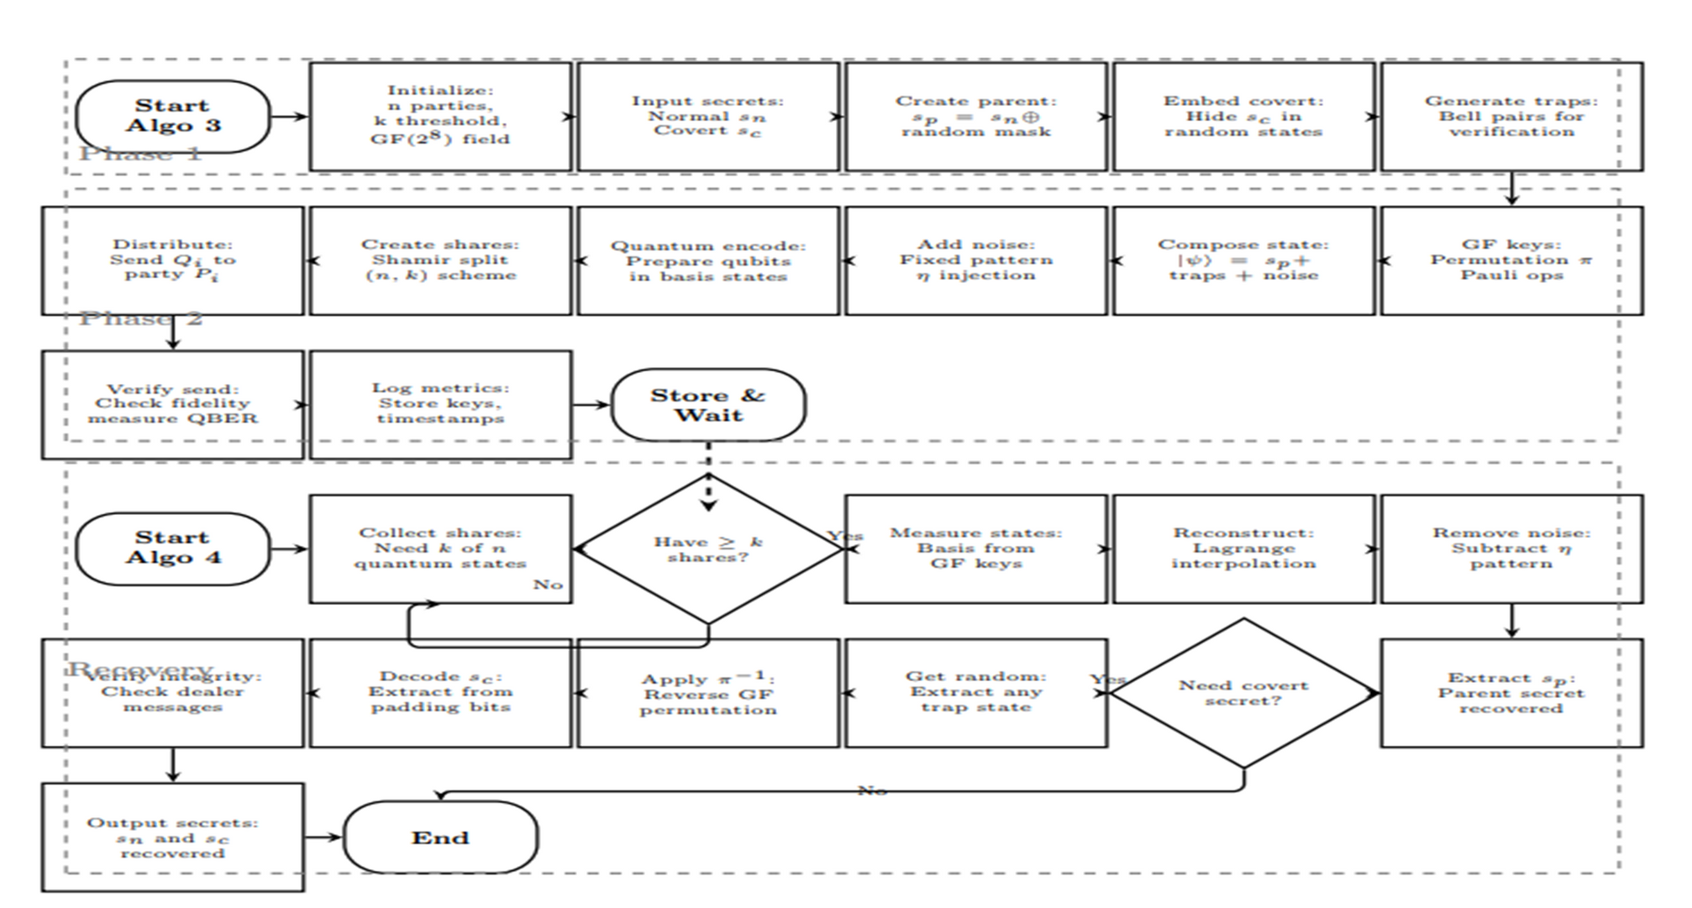
Workflow of Reconstruction

Slide 37
Algorithm 3: - Reconstruction of Normal Secret
Purpose :
  Goal: Reconstruct the original normal secret |S⟩ from distributed shares across multiple generations.
  Method: Bottom-up reconstruction starting from the most recent generation.
  Key insight: Reverses the composite state construction by systematically peeling back layers.
Inputs :
  Input Requirements:
  g → Last generation index
  P = (f₁, f₂, ..., fg) → Tuple indicating participants from each generation
  Shares from qualifying parties meeting threshold k(t)
  Classical keys: k₁, k₂ (recovered via CRecTh)

Slide 38
Algorithm 3: Step-by-step (Procedures summary)
Procedure 3a — Reconstruct Generation States
  Start with generation Gg.
  Apply QRecTh(fi, |Gi|) to recover random states.
|r(f₁)⟩, |r(f₁,f₂)⟩, ..., |r(f₁,...,fg)⟩
  Use QRecTh(kI - Σ^(g-1)_(i=1) fi, i) to obtain:
|S(f₁,...,fg-1)⟩ = |Sparent(P)⟩
Iterative Parent Recovery:
•For j = g-1 down to 1:
1. Apply inverse Pauli: P⁻¹_k2
2. Apply inverse permutation: σ⁻¹_k1
3. Extract first n quantum lines
4.Decode QECC: Dec(Stemp(parent(P)))
5. Obtain |S(f₁,...,fj-1)⟩
End Output: |S⟩ (original secret)

Slide 39
Algorithm 3: Why these design choices matter
  Bottom-up approach → Ensures proper unwinding of generation-based encoding.
  Inverse operations in exact reverse order→ maintains quantum coherence during reconstruction.
  Threshold verification at each level → Prevents partial reconstruction attacks.
  QECC decoding last → Error correction happens after removing masking layers.

Slide 40
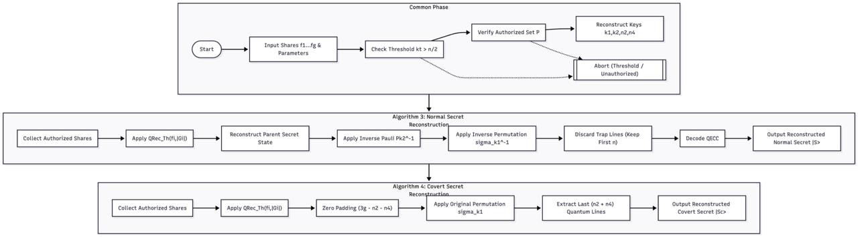

Slide 41
Algorithm 4: Reconstruction of Covert secret (QAESS RECONcov)
  Input Requirements: To verify that the Any reconstructured random states |r(f₁,...,fi)⟩
  Classical parameters: n₂, n₄ (via CRecTh) - Permutation key σk1 containing σcov
Main Reconstruction Steps :
  Select random state: Choose any |r(f₁,...,fi)⟩ from reconstructed states
  Prepare extraction Template:
|Temp3⟩ = |⊥⟩^⊗(3g-n₂-n₄) ⊗ |Temp2⟩
  Apply permutation:
σk1(|Temp3⟩) = |⊥'⟩ ⊗ σcov(|Temp1⟩) =|⊥'⟩ ⊗ |Sc⟩
  Extract covert message:
-Take only last (n2+ n4) quantum lines.
- Result: |Sc⟩ (covert secret)

Slide 42
Reconstruction Verification and Security
1.Threshold Check:
  Verify Σfi ≥ k(t) before reconstruction
  Abort if insufficient parties
2. Key Consistency:
  Cross-verify k₁, k₂ across multiple parties
  Check trap measurement outcomes match expected patterns
3. Reconstruction Validation:
  For normal secret: Verify QECC syndrome = 0
  For covert secret: Check n₂ zeros, n₄ ones pattern

Slide 43
Limitations of Algo 3 & 4
  Normal and covert secrets are reconstructed separately, with no final cross-check.
  σₖ₁ and σ_cov aren’t jointly validated, so trap structure and permutation may misalign.
  Covert extraction depends on one random state without verifying it against full QECC output.
  After redistribution, no combined integrity check ensures both secrets match one composite state.

Slide 44
Procedure Followed in Algorithm 7 (Reconstruction-II)
1) Rebuild the Normal Secret
  Run Algorithm 3 once to remove Pauli mask + permutation and decode QECC to obtain a trusted |S⟩.
2) Select and Align a Random State
  Pick any reconstructed random state r(f₁,…,fᵢ) and prepare the extended template for trap alignment.
3) Apply σₖ₁ for Covert Extraction
  Use the same permutation key σₖ₁ to realign the trap-based block, extract the
(n₂ + n₄) trap positions, and obtain |S_c⟩.
4) Unified Verification
  Check that QECC output and trap pattern match one composite structure, ensuring |S⟩ and |S_c⟩ originate from the same encoded state.

Slide 45
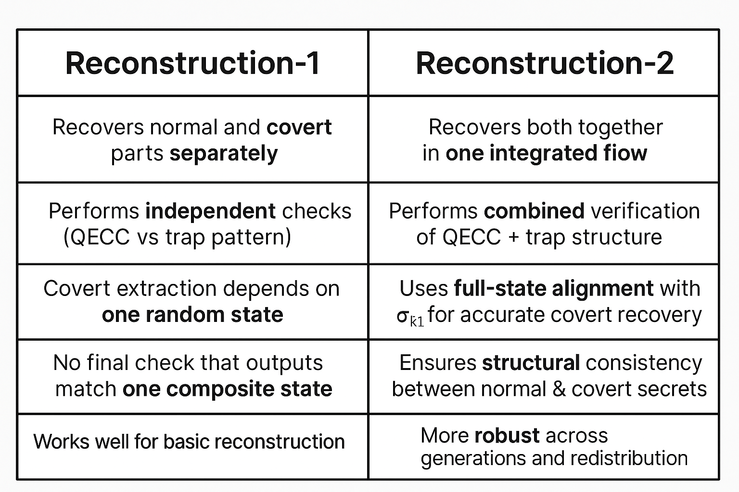
Reconstruction-1 vs Reconstruction-2

Slide 46
Result
Execution Time :
  Block - 1 = 10.817 sec - install qiskit & qiskit - aer
  Block - 2 = 121.736 sec - Algorithm 6
  Block - 3 = 0.416 sec - Algorithm 2
  Block - 4 = 2.979 sec - Algorithm 7
  Total Execution Time: 135.948 seconds or 2.27 minutes

Slide 47
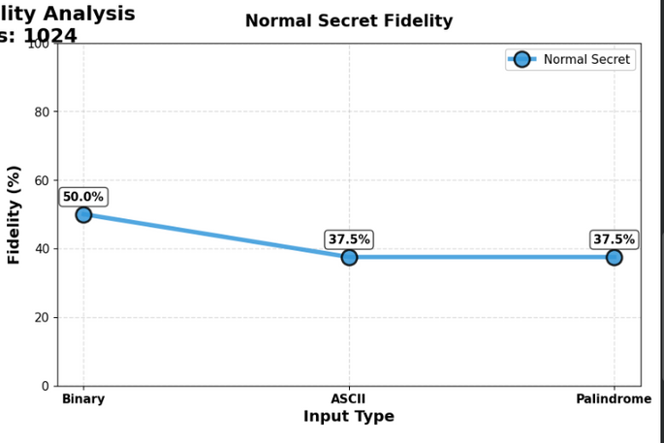
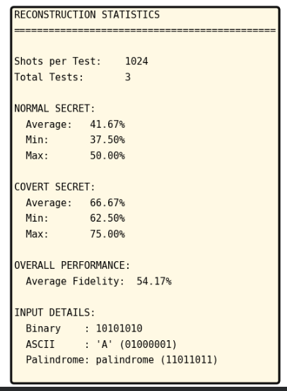
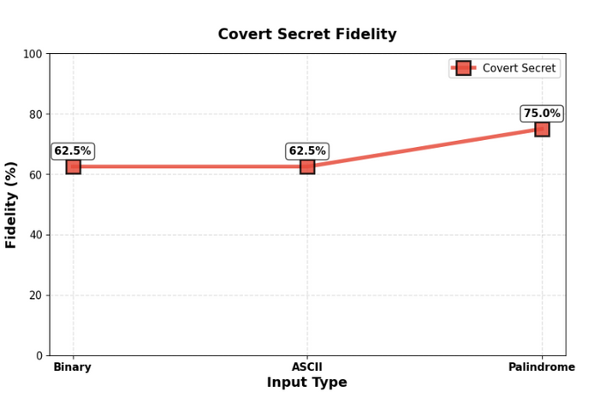
Result

Slide 48
Tools & Technologies
Implementation Platform
  Framework: Qiskit 2.2.3
  Quantum Backend: qiskit-aer (Version 0.17.2)
  Programming Language: Python 3.10
  Environment: Google Colab
  Supporting Libraries: NumPy, hashlib, pickle
  Simulator Used: AerSimulator (statevector mode)
  Total Execution Time: 135.948 seconds
Attack Models Evaluated
• Photon Number Splitting (PNS) attack detection
• Man-in-the-Middle (MITM) anomaly detection
• Trojan-Horse dimension-based intrusion detection
• Intercept-Resend basis-matching deviation test
Parameters Tested
• Input Types: Binary, ASCII, and Palindrome
• Secret Levels: 2 levels (8-bit normal secret + 6-bit covert secret)
• Reconstruction Technique: Galois Field GF(2¹³) for k₁ and k₂
• Verification: SHA-512 hashing and Shannon entropy indistinguishability
• Fidelity Check: Fidelity graph used for state-disturbance validation

Slide 49
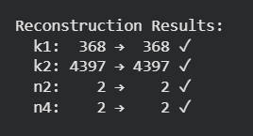
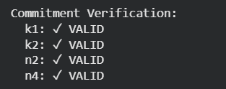
Result & Findings
  Three input types processed: Binary, ASCII, and Palindrome.
  Four attack scenarios evaluated with consistent system behavior.
  Hashing applied using the SHA-512 technique to ensure integrity.
  Fidelity graph generated confirming stable quantum-state performance.
  The overall execution time was 135.948 seconds.

Slide 50
Influence on Future Research
  Establishes a foundation for quantum anamorphic encryption as a deployable protocol.
  Guides the design of scalable covert communication in dynamic quantum networks.
  Inspires future work on spy-resilient, noise-tolerant quantum secret sharing protocols.

Slide 51
Conclusion
  QAESS schemes rely on trap codes but do not use Galois field structures for efficient share generation.
  Reconstruction through inverse operations enables dual-layer secret recovery while preserving quantum no-cloning constraints.
  Trap-based covert extraction maintains zero dimensional overhead for hidden messages.
  Generation-wise threshold verification ensues adaptive security against evolving adversarial threats.

Slide 52
References
  Chaudhury, S.S. and Ganguly, S., 2025. Construction of Quantum Anamorphic Evolving Dynamic Threshold Secret-Sharing Schemes. IEEE Transactions on Communications.
  Kutyłowski, M., Persiano, G., Phan, D.H., Yung, M. and Zawada, M., 2023, August. Anamorphic signatures: Secrecy from a dictator who only permits authentication!. In Annual International Cryptology Conference (pp. 759-790). Cham: Springer Nature Switzerland.
  Banerjee, S., Pal, T., Rupp, A. and Slamanig, D., 2025. Simple Public Key Anamorphic Encryption and Signature using Multi-Message Extensions. Cryptology ePrint Archive.
  Ganguly, S. and Chaudhury, S.S., 2025. Computational Quantum Anamorphic Encryption and Anamorphic Secret Sharing. Cryptology ePrint Archive..

Slide 53
References
  Chu, H., Do, K., Hanzlik, L. and Thyagarajan, S.A., 2025. When Threshold Meets Anamorphic Signatures: What is Possible and What is Not!. Cryptology ePrint Archive.Banerjee, S., Pal, T., Rupp, A. and Slamanig, D., 2025. Simple Public Key Anamorphic Encryption and Signature using Multi-Message Extensions. Cryptology ePrint Archive.
  Senthoor, K. and Sarvepalli, P.K., 2022. Theory of communication efficient quantum secret sharing. IEEE Transactions on Information Theory, 68(5), pp.3164-3186.

